Slide 1


FRAM
Frontiers in Arctic Marine Monitoring
Focus region Fram Strait
Recent scientific results

Slide 2
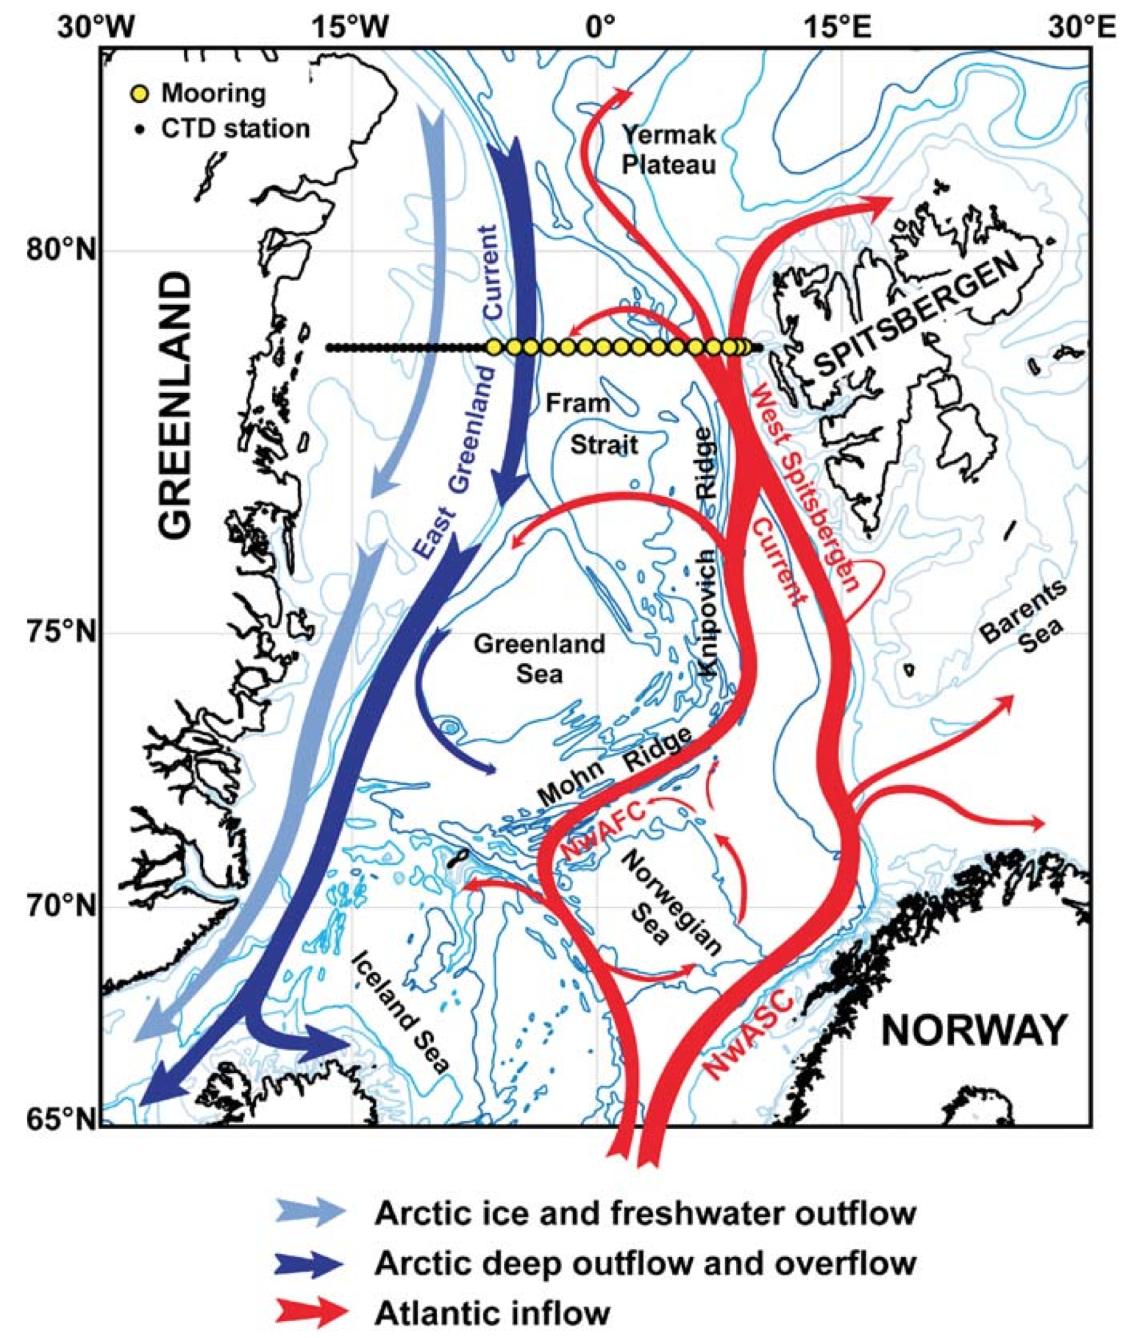
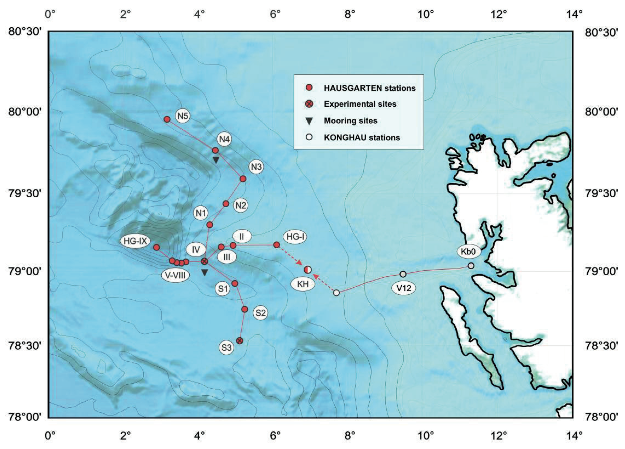
Fram Strait
Beszczynska-Möller et al, 2012
Soltwedel, 2010
Notes:
Map of Agnieszka array
Map of Hausgarten array

Slide 3
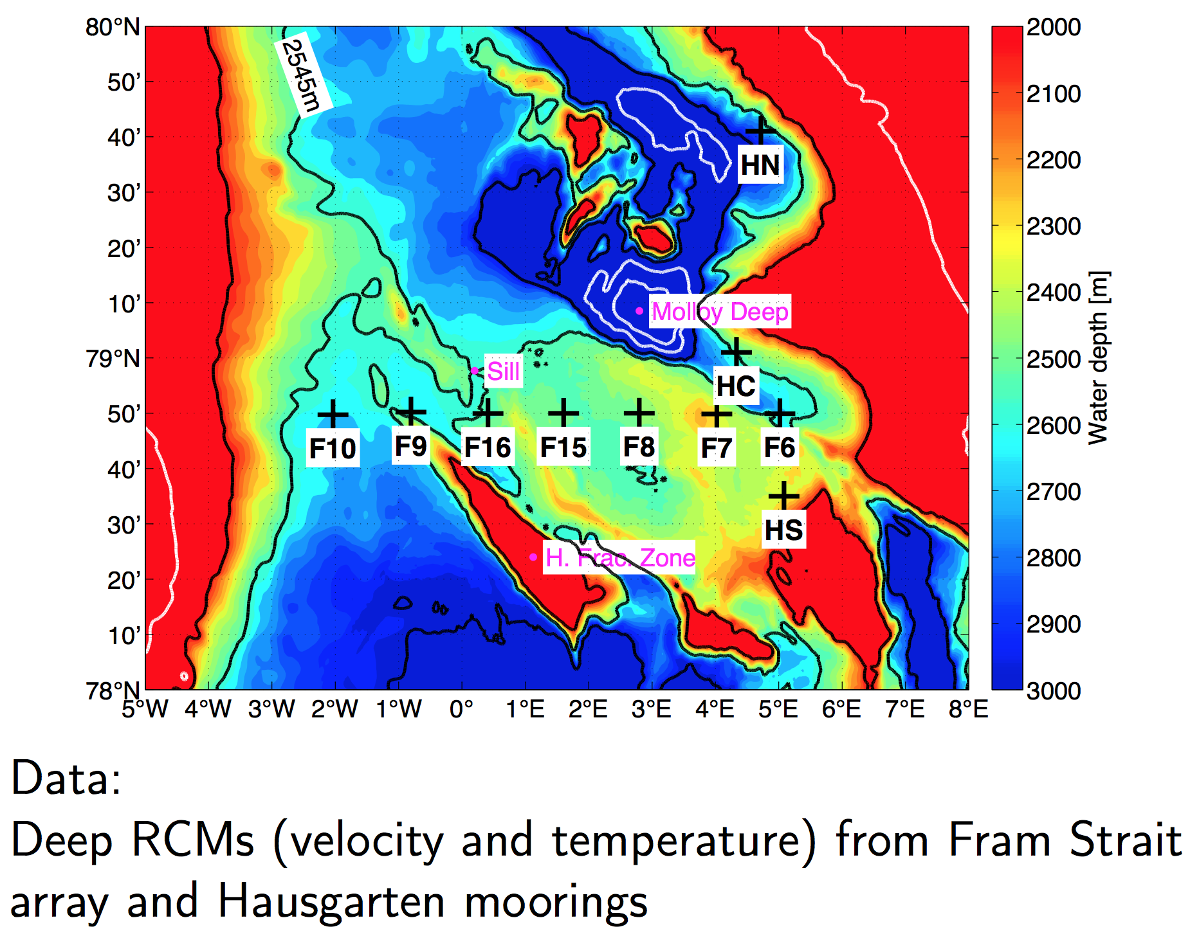
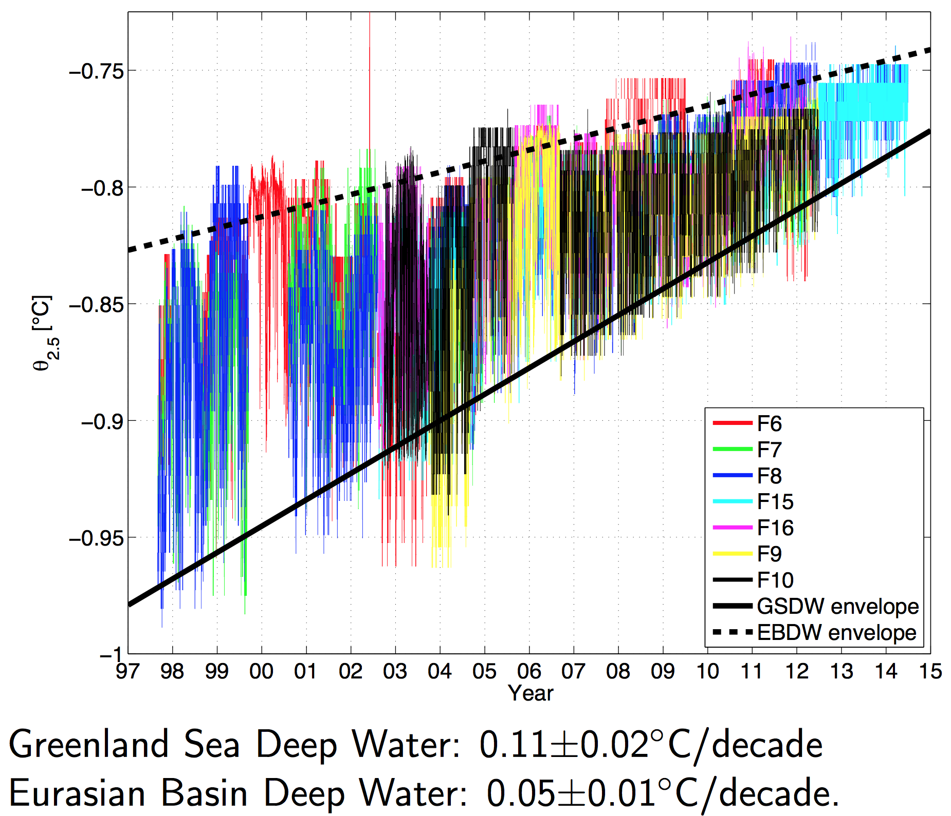
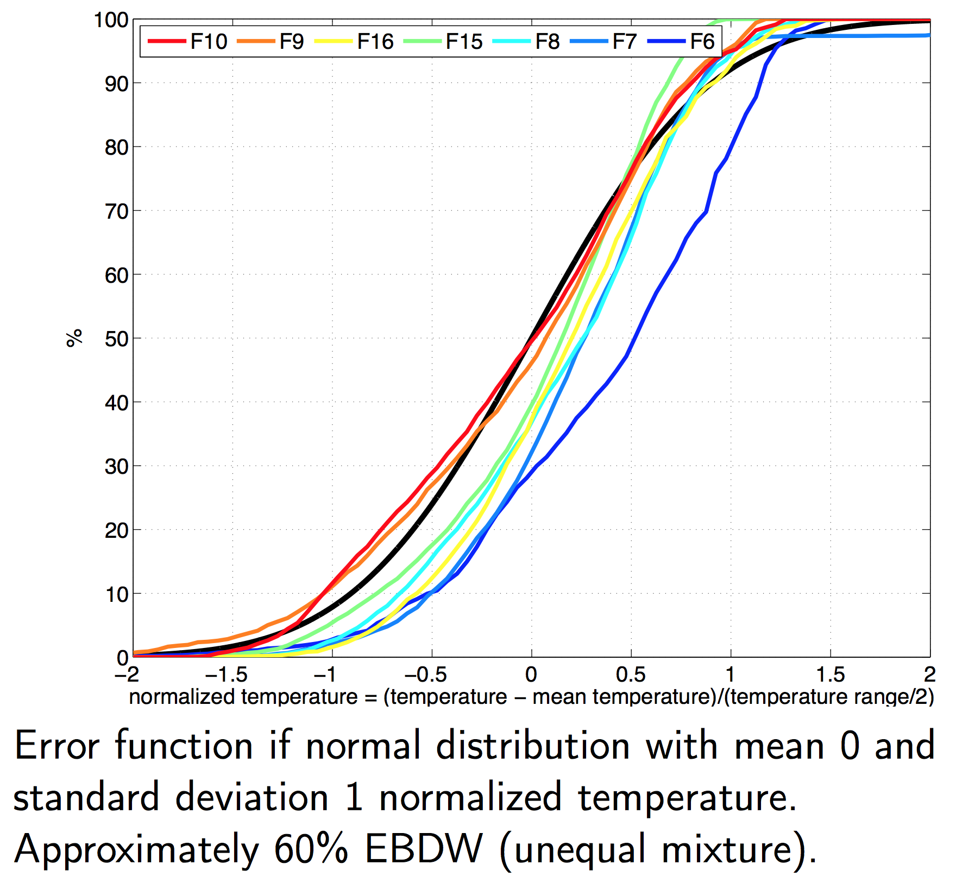
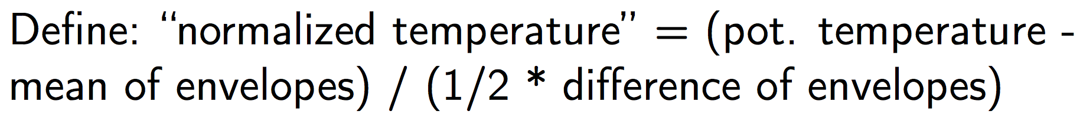
Warming of deep waters
von Appen et al, 2015

Slide 4
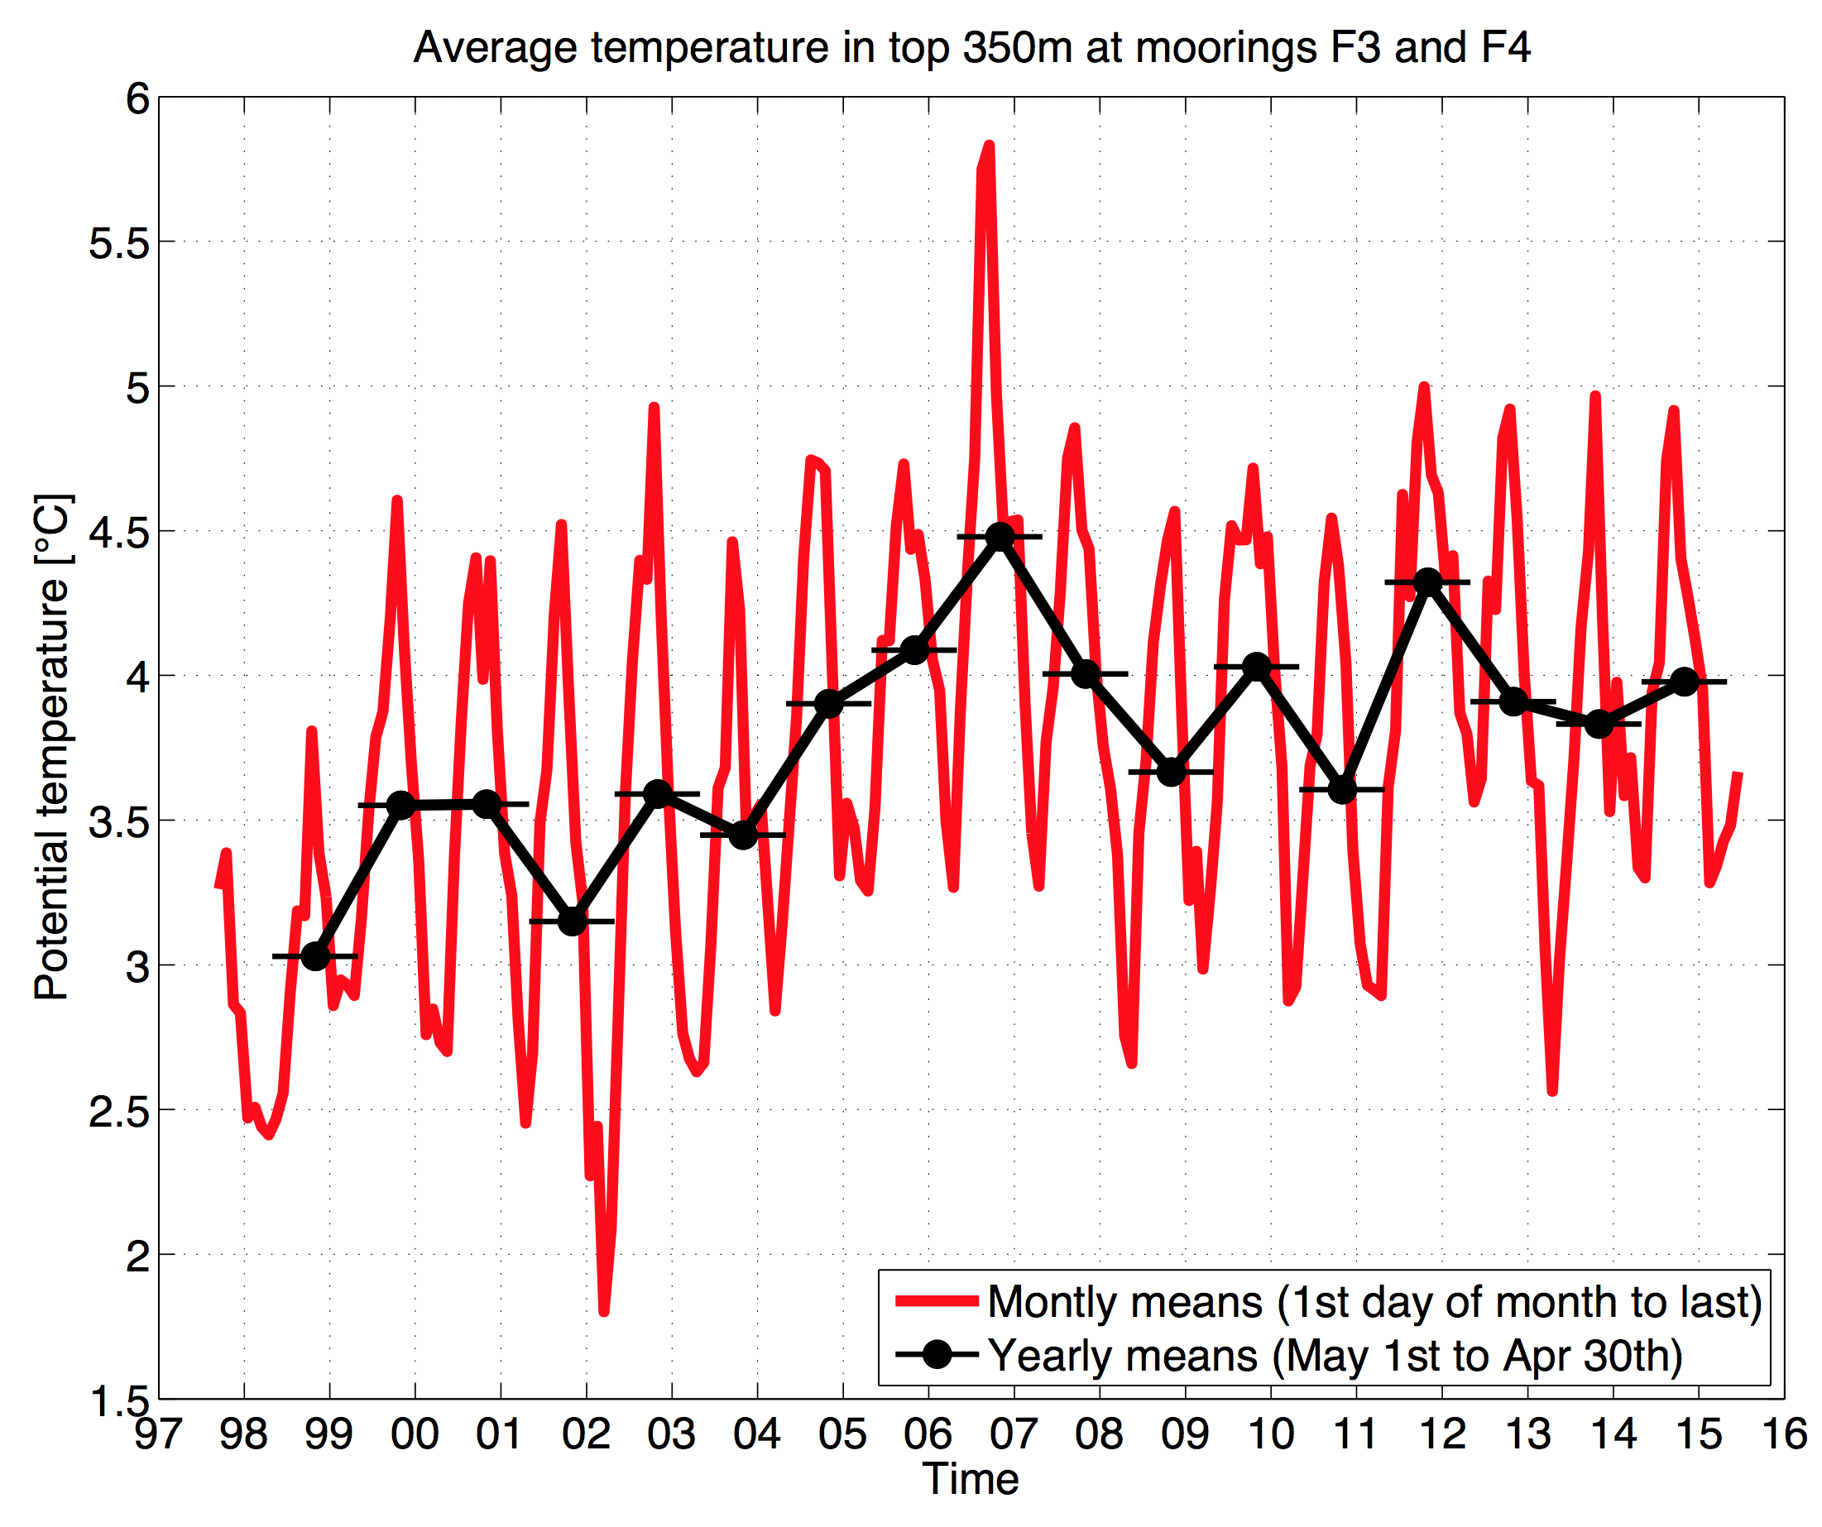
Atlantic Water temperature
von Appen, unpubl.
Notes:
Agnieska time series
My time series

Slide 5
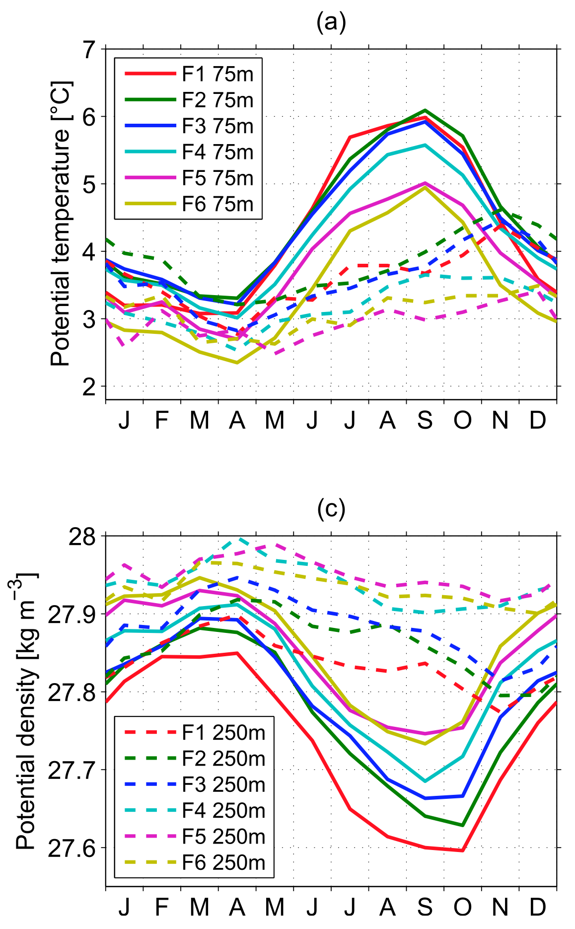
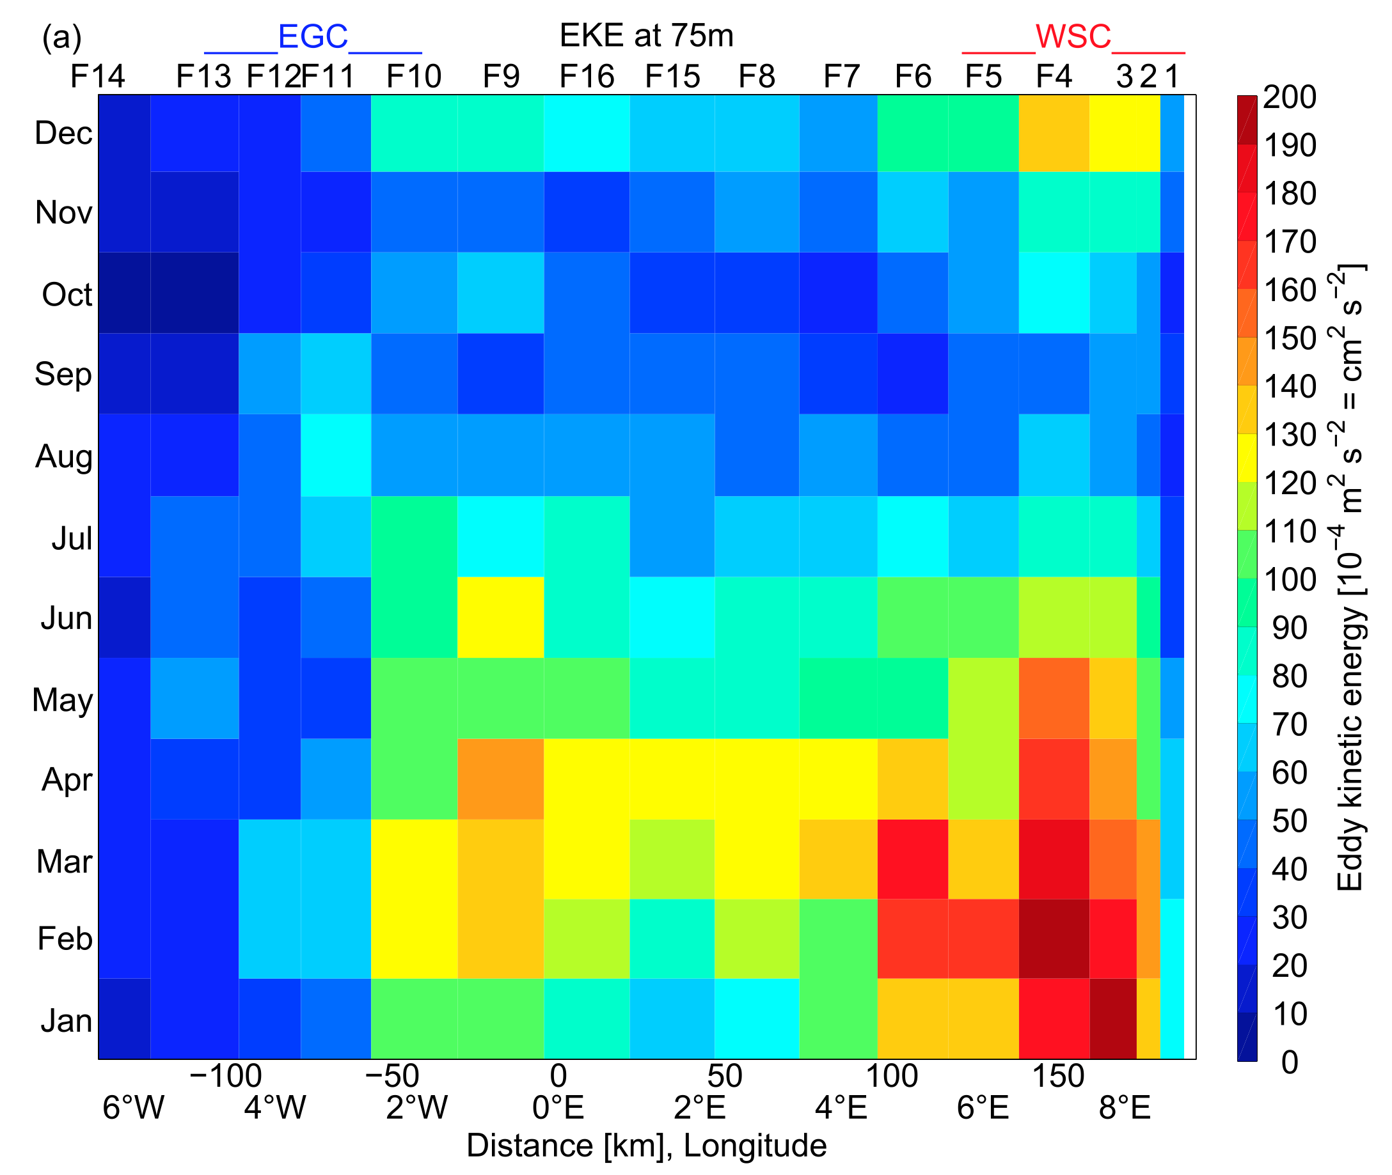
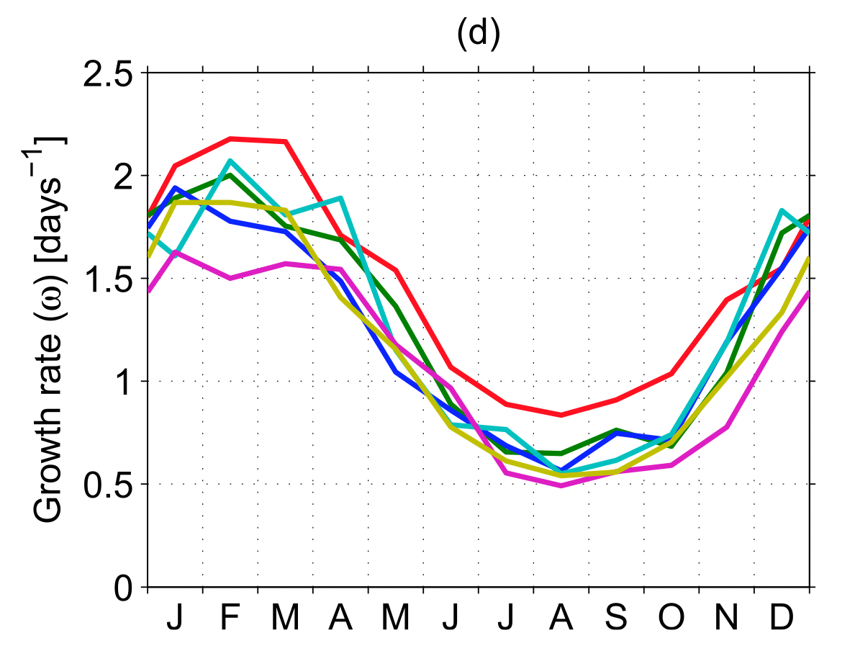
Upper ocean seasonal cycle
Ri = N²/S²
ω² = 0.09 f²/(1+Ri)
EKE = 0.25 ω²R_{d}²
von Appen et al, 2016
Notes:
EKE
Tem
Growth rate

Slide 6
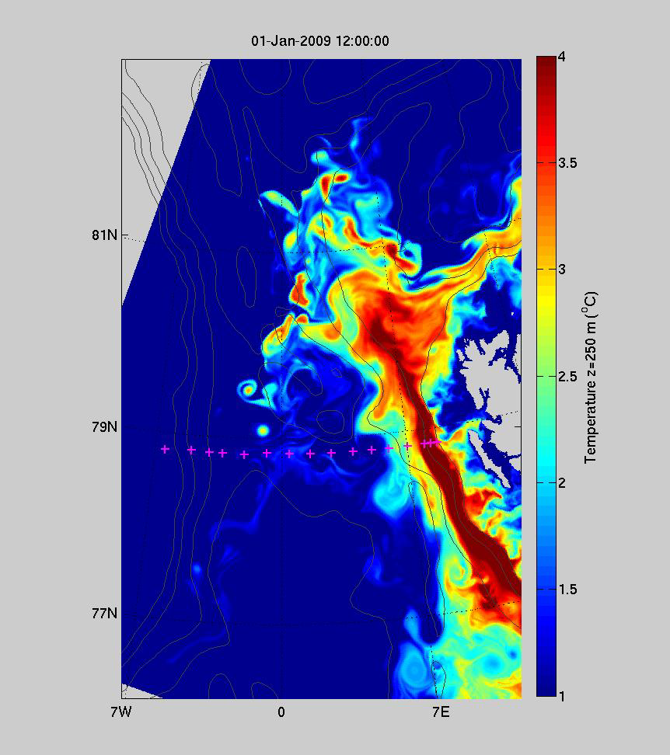
Mesoscale variability
800m horizontal resolution
Temperature at 250m depth
Hattermann et al, 2016
Notes:
Snapshot/video from Tore

Slide 7
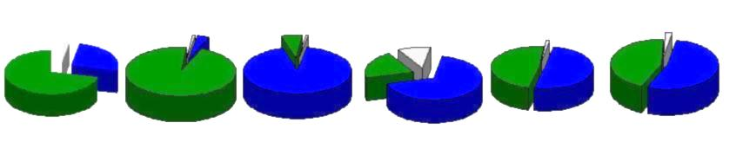
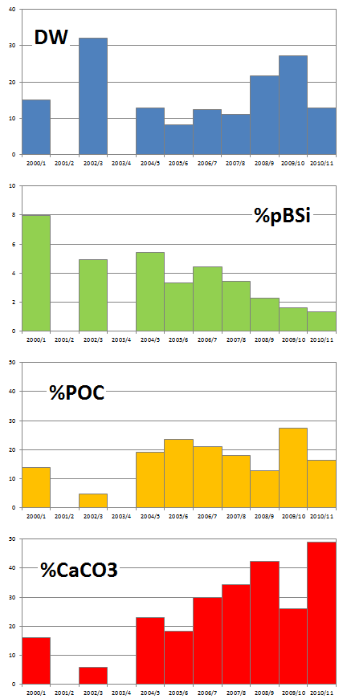
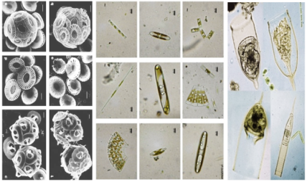
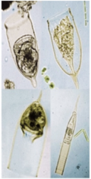
pelagic time-series…
2000/1
2002/3
2004/5
2005/6
2006/7
2008/9
Coccolithophorids Diatoms Tintinnids
Temporal variability of plankton species
in sediment traps between 2000 and 2009
(Bauerfeind et al., 2009 and unpubl. data)
Temporal variations
in the particle fluxes
between 2000 and 2011
(Nöthig & Bauerfeind, unpubl. data)
Notes:
PHYTOPLANKTON (from Sediment Trap time series)
there always have been variations in primary producers with a silicate and a calcareous shell
however the relative proportion of calcium carbonate (coccolitophores) continuously increased, while particulate biogenic silicate (diatoms) decreased

Slide 8
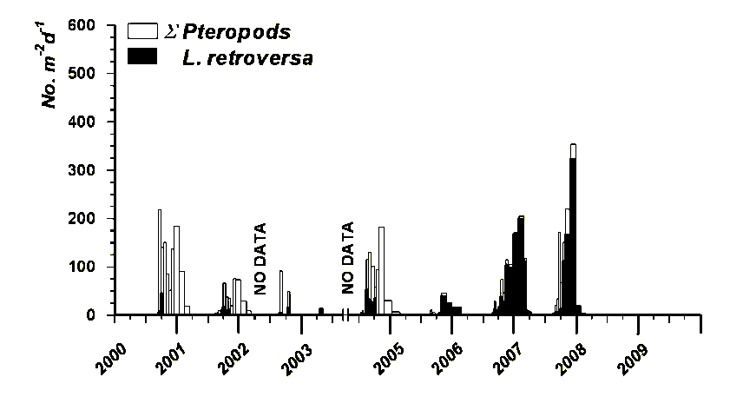
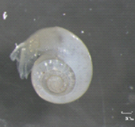
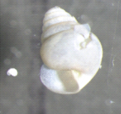
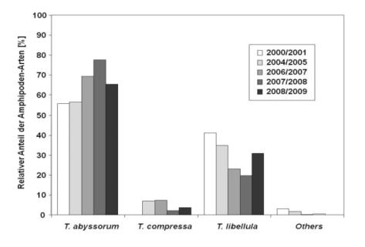
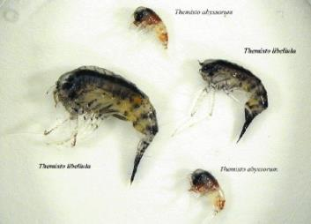
pelagic time-series…
*
Strong increase of
Limacina retroversa shells
in sediment traps
between 2006 and 2008.
(Bauerfeind et al., unpubl. data)
*
*
Relative proportions
of Themisto libellula * (polar) and
Themisto abyssorum (boreal-subpolar)
in sediment traps
between 2000 and 2009
(Kraft et al., 2010)
*
Notes:
Zooplankton (from sediment trap time series)
strong increase in Limacina from 2007 on
Amphipods: polar amphipod species were replaced by rather boreal species

Slide 9
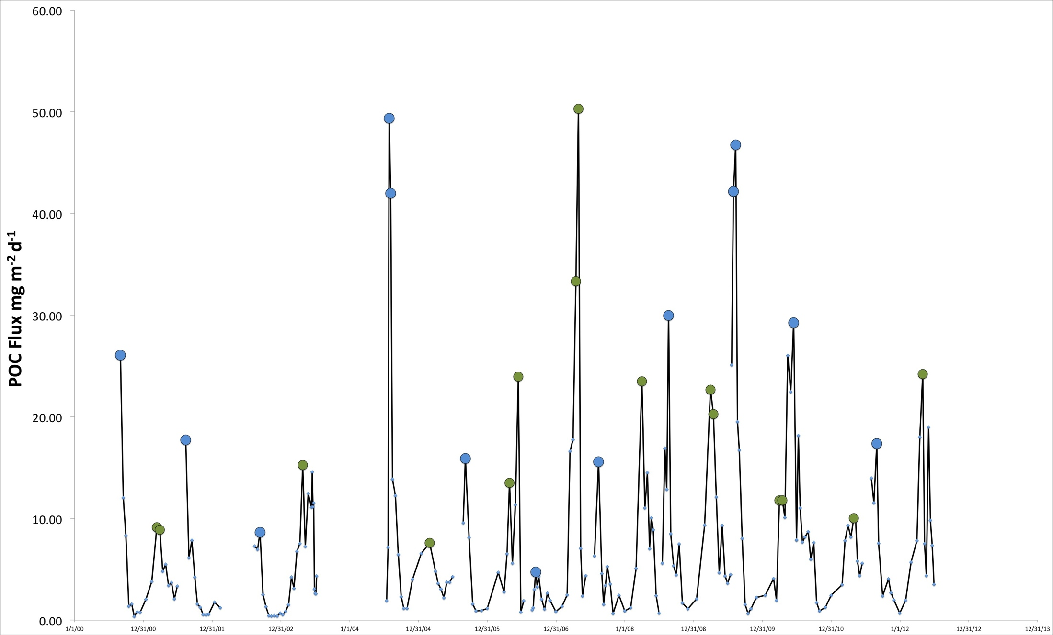
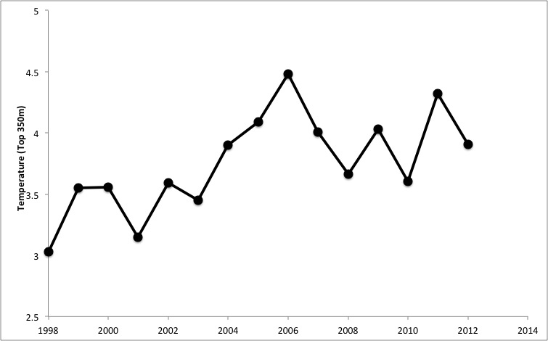
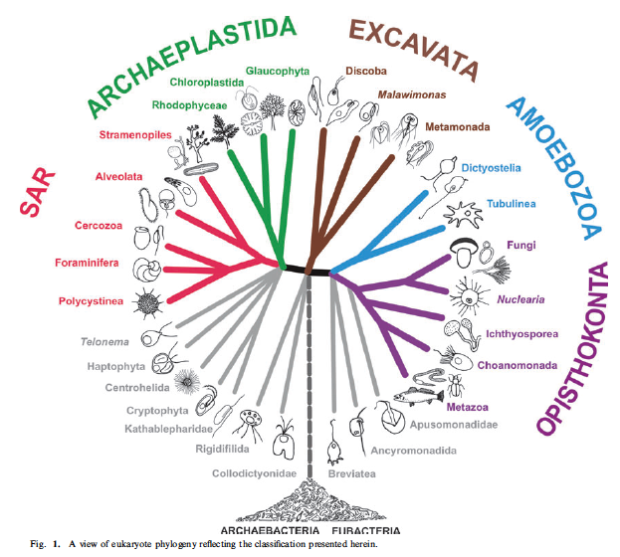
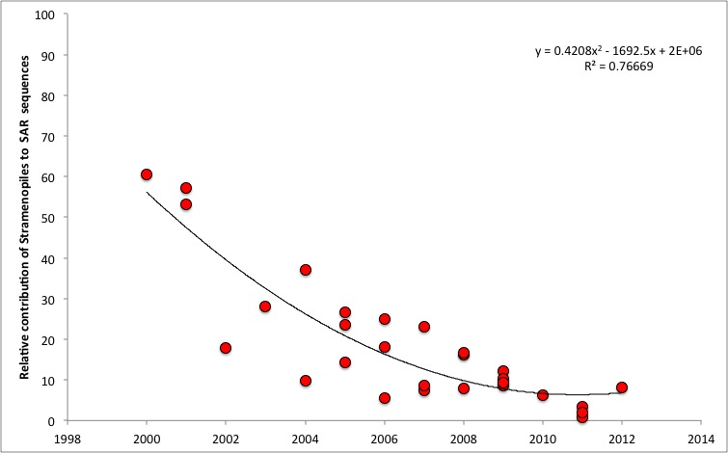
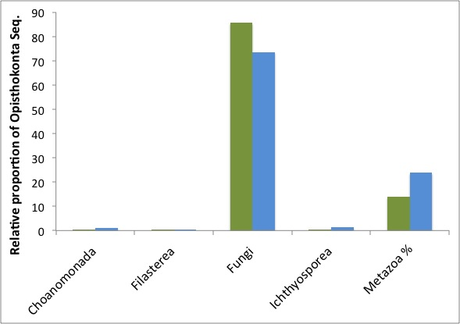
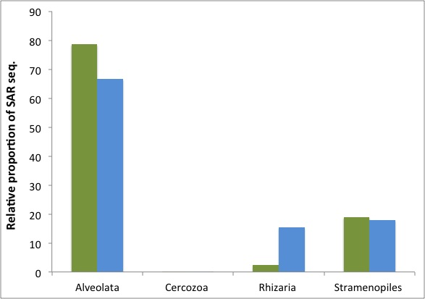
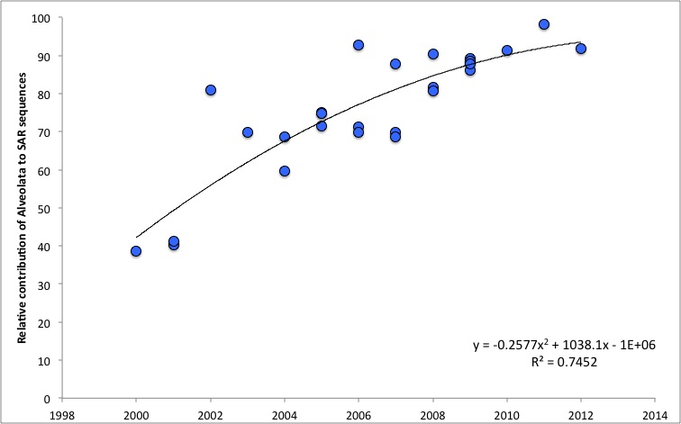
Legacy sequencing of archived samples
(a) Adl et al. 2012
(b) POC flux 2000-2012 (200m)
(e) Temperature
Spring flux sequences
(f) Stramenopiles
Summer flux sequences
(c) Opisthokonta
(d) SAR
(g) Alveolata
Salter et al. unpublished data
Notes:
12 year time-series of POC flux at 200m, exhibits bi-modal flux pattern with peaks in Spring and late summer (b)
These flux peaks were selected for next generation sequencing of 18S ribosomal gene –taxonomy adheres to revised classification of Eukaryotes (a)
(c) Documents importance of fungi, slightly enhanced during spring – seem to be parasites associated with diatom export, enhanced contribution of metazoa (zooplankton signals) in autumn peak
(d) dominance of alveolata, e.g. dinoflagellates and ciliates. Rhizaria, heterotrophs such as foraminfera and radiolaria enhanced during summer flux
(f+g) – seems to be a shift in the importance of alveolate (includes dinoflagellates) and Stramenopiles (diatoms) comprising POC flux that may reflect increasing temperature trends in the region (e).
Pilot study to show that legacy sequencing of archived sediment trap samples appears capable of documenting seasonal and inter-annual trends in upper ocean plankton communities.

Slide 10
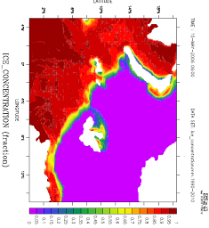
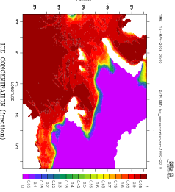
benthic time-series…
ANOSIM: Global R=0.5***
2003
“Polar Year”
2008
2006
2003
2006
“Atlantic Year”
2009
2004
2007
ANOSIM:
2009 vs others: R>0.75*
2009 vs 2008: R=0.45**
2008 vs 2006: R=0.66*
2008
“Polar Year”
Stress= 0.14
Variability in the bacterial composition in surface sediments from the central HAUSGARTEN site between 2003 and 2009
(Jacob, in prep.)
Notes:
on the left: ice coverage
bacteria might account up to 90% of benthic biomass
here the similarity of investigated bacterial populations of several years is compared (MDS-plot)
they show clear dissimilarities between cold an warm years
communities from 2003, 2009 and 2008 are significantly different from those of 2006 and 2007

Slide 11
Questions?
Notes:
Agnieska time series
My time series

